Slide 1
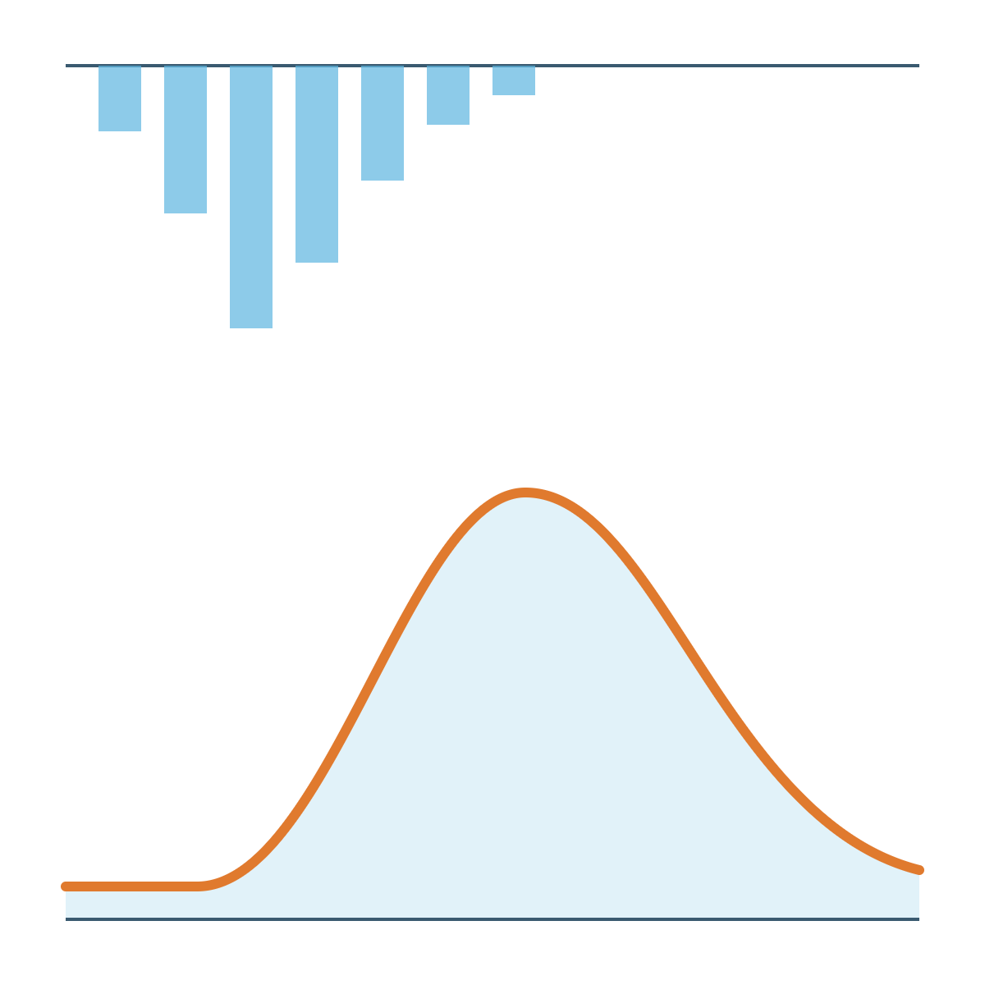
Accelerating flood model development with custom QGIS plugins
FLOOD MODELLING TEAM · KNOWLEDGE SHARE
FMB Tools 0.10 · Rain2Flood v3.0 · Building your own plugin
Rahul Pandey
Senior Engineer, Flood Modelling · AtkinsRéalis · [Date]
Notes:
Introduce yourself. Today: two tools I built to speed up our modelling work, FMB Tools for building TUFLOW models in QGIS (the main focus) and Rain2Flood for hydrology (a bonus), then how anyone in the team can build their own QGIS plugin.

Slide 2
Four parts, one idea: let QGIS do the repetitive work
AGENDA
01
02
03
04
Why
FMB Tools 0.10
Rain2Flood v3.0
Build your own
Where the time goes when TUFLOW models are built by hand
Control files, batch files and QC built inside QGIS
Hydrology from rainfall to flood hydrograph
How a QGIS plugin works and how to start one
Main focus
Bonus
Hands-on
Notes:
Set expectations: most of the time goes on FMB Tools. Rain2Flood is a short bonus. We finish with how to build a plugin, so anyone can turn a repetitive task into a tool.

Slide 3

A TUFLOW model is a stack of hand-edited text files
THE PROBLEM
TYPICAL MODEL FOLDER
model.tcf
model.tgc
Commands typed from memory or copied from an old model
model.tbc
model.ecf
A typo or wrong path only shows up when the run stops
materials.tmf
Checking means reading the log and message layers by hand
bc_dbase.csv
run.bat
Every modeller lays out files a little differently
Notes:
Ask the room: who has lost time to a typo in a control file, or a wrong path that only appeared at run time? The tooling is plain text editors, and that is where most of the friction comes from.

Slide 4
What if the model build lived where the data already lives: in QGIS?
THE QUESTION
That question became FMB Tools.
Notes:
Pause here. Our GIS layers are already in QGIS, so the control files that reference them should be built there too.

Slide 5

Build TUFLOW models inside QGIS, not in Notepad++
FMB TOOLS 0.10
One tab per control file
SCREENSHOT
Batch files generated, not hand-typed
FMB Tools main window
QC, log and results views built in
The plugin open in QGIS with a model loaded
Help tab links to the TUFLOW Wiki
Open source, on GitHub
Notes:
FMB Tools started as "TUFLOW Model Builder" and was renamed. Version 0.10 is what I am showing today. The goal: everything you used to do in Notepad++ for a TUFLOW build now happens in one QGIS panel.

Slide 6

From blank model to checked results in one place
FMB TOOLS 0.10 · WORKFLOW
Step 1
Step 2
Step 3
Step 4
Step 5
Build control files
Create batch file
Run the model
QC and log
Review results
TUFLOW runs from the generated batch file
Check messages and the log inside QGIS
TCF, TGC, TBC, ECF and more, one tab each
The .bat is written for you
Results next to the GIS layers they came from
No switching between a text editor, a file browser and QGIS: the whole build stays in one window.
Notes:
Walk through the five steps quickly here; the next slides show each one with screenshots. If doing a live demo, this is the slide to switch from.

Slide 7
Control files, one tab each
FMB TOOLS 0.10 · STEP 1
Forms, not syntax
Fill in commands and files; the plugin writes the TUFLOW control files.
SCREENSHOT
Every file in one window
Control file tabs
Move between TCF, TGC, TBC and ECF without a text editor.
The TCF tab filled in, with the other file tabs visible
Help on hand
The Help tab links to the TUFLOW Wiki for command details.
Notes:
Show how a control file is built from the tab instead of typed. Point out the Help tab, which saves a separate search of the TUFLOW Wiki.

Slide 8
Batch files without hand-typed paths
FMB TOOLS 0.10 · STEPS 2 AND 3
Generated from your setup
The batch file is built from the model you just defined.
Same structure every time
SCREENSHOT
Run files look alike across the team, so anyone can pick one up.
Batch file builder
The batch tab and the .bat it produces
Run options
[List the run options 0.10 supports, such as events or scenarios]
Notes:
Show the generated .bat side by side with the form. Mention that consistent run files make reviews and hand-overs easier.

Slide 9
QC, log and results without leaving QGIS
FMB TOOLS 0.10 · STEPS 4 AND 5
SCREENSHOT
SCREENSHOT
QC and log view
Results view
Messages and log from a run, read inside QGIS
Model results loaded next to the input layers
Notes:
The point here is closing the loop: build, run, check and review in the same tool. Errors are found in QGIS, next to the layers that caused them, rather than by scrolling a log in a text editor.

Slide 10
What changes for the modeller
FMB TOOLS 0.10 · BEFORE AND AFTER
Task | By hand in Notepad++ | With FMB Tools
Control files | Typed, or copied from an old model | Built from tabbed forms
Batch file | Edited for each run | Generated by the plugin
Finding errors | After a run stops, in the log | QC view inside QGIS
Command help | A separate TUFLOW Wiki search | Help tab linked to the Wiki
Time to first run | [__ hours] | [__ hours]
Notes:
Fill in the last row with a real timing from one of your projects before presenting; one honest number lands better than a general claim.

Slide 11
From rainfall to flood hydrograph, inside QGIS
BONUS · RAIN2FLOOD V3.0
01
02
03
04
Catchment
Rainfall
Runoff
Routing
Streams and sub-basins with GRASS r.watershed
DEM and slope processing with styled outputs
Frequency analysis with several distributions
Design rainfall for chosen return periods
SCS-CN, Green-Ampt and Horton losses
SCS, Snyder, Clark and Nash unit hydrographs
CN rasters from ESA WorldCover and SoilGrids
Muskingum-Cunge channel routing
2D diffusive-wave engine, in development
Notes:
Keep this short: three to five minutes. Rain2Flood covers the hydrology that sits upstream of a hydraulic model. Version 3.0 followed a full hydrology audit and bug-fix pass.

Slide 12
Rain2Flood in action
BONUS · RAIN2FLOOD V3.0
SCREENSHOT
SCREENSHOT
Streams and sub-basins tab
Hydrograph output
A delineated catchment on the map
A design flood hydrograph for one return period
Notes:
Two screenshots are enough: the catchment it delineates and the hydrograph it produces. Mention that hydrographs like these are what feed the inflow boundaries of a hydraulic model.

Slide 13
A QGIS plugin is just a folder of Python files
BUILD YOUR OWN
my_plugin/
Goes in your QGIS profile's plugins folder
├── metadata.txt
Name, version, author, minimum QGIS version
├── __init__.py
classFactory(iface): QGIS calls this to load the plugin
├── my_plugin.py
initGui() adds buttons, unload() removes them, run() does the work
├── my_dialog.ui
The window, laid out in Qt Designer
└── icon.png
The toolbar icon
Windows: %APPDATA%\QGIS\QGIS3\profiles\default\python\plugins
Notes:
Demystify it: no compiler, no installer. Drop the folder into the plugins directory, restart QGIS or use Plugin Reloader, and it appears in the Plugin Manager. FMB Tools and Rain2Flood follow exactly this structure, just with more files.

Slide 14
A working plugin in three small files
BUILD YOUR OWN · CODE
__init__.py
hello.py
def classFactory(iface):
from qgis.PyQt.QtWidgets import QAction, QMessageBox
from .hello import HelloPlugin
class HelloPlugin:
return HelloPlugin(iface)
def __init__(self, iface):
self.iface = iface
def initGui(self):
metadata.txt
self.action = QAction("Hello", self.iface.mainWindow())
[general]
self.action.triggered.connect(self.run)
name=Hello Flood Team
self.iface.addToolBarIcon(self.action)
qgisMinimumVersion=3.22
def unload(self):
description=My first plugin
self.iface.removeToolBarIcon(self.action)
version=0.1
def run(self):
author=Your Name
layer = self.iface.activeLayer()
email=you@example.com
name = layer.name() if layer else "none"
QMessageBox.information(None, "Hi", f"Layer: {name}")
Notes:
Put these three files in a folder called hello inside the plugins folder (the import in __init__.py points at hello.py). Enable it in the Plugin Manager and a button appears that shows the active layer's name. Everything else, including FMB Tools, is this pattern plus a dialog and real logic. Before publishing to plugins.qgis.org, metadata.txt also needs about, repository and a licence.

Slide 15
From idea to installed plugin in six steps
BUILD YOUR OWN · WORKFLOW
01
02
03
Scaffold it
Design the window
Try code in the console
Plugin Builder 3 creates the folder, metadata and a starter dialog.
Qt Designer, installed with QGIS, lays out buttons and inputs.
Test PyQGIS lines in the QGIS Python Console before they go in the plugin.
04
05
06
Reload as you edit
Version it
Share it
Plugin Reloader picks up changes without restarting QGIS.
Commit to Git and push to GitHub from day one.
Zip the folder for colleagues, or publish on plugins.qgis.org.
Notes:
Plugin Builder 3 and Plugin Reloader are both free plugins from the Plugin Manager. Step 3 is the biggest time saver: get a line of PyQGIS working in the console, then move it into the plugin.

Slide 16
What building these taught me
LESSONS FROM FMB TOOLS AND RAIN2FLOOD
Start with one annoying task
Expect to rewrite the engine
FMB Tools began with a single goal: stop editing TUFLOW files in Notepad++.
Rain2Flood's delineation went from pure-Python D8 to pysheds, then a vectorised sparse search, then GRASS r.watershed.
Check the science, not just the code
Lock in fixes with tests
A hydrology audit found FEH QMED formula errors that were underestimating flows.
Regression tests and NumPy 2.0 fixes keep v3.0 working as libraries change.
Notes:
The QMED story is the one to tell: the code ran without errors but gave low flows. Tools that look finished still need an engineering check, which is where this team's expertise matters most.

Slide 17
Where to start
RESOURCES
Resource | Link
PyQGIS Developer Cookbook | docs.qgis.org/latest/en/docs/pyqgis_developer_cookbook
PyQGIS API reference | qgis.org/pyqgis
QGIS plugin repository | plugins.qgis.org
TUFLOW Wiki | wiki.tuflow.com
FMB Tools and Rain2Flood | github.com/rahulpandey696
Notes:
Share this slide or the links after the session. The Cookbook is the best single starting point; the API reference is for looking up classes once you know what you need.

Slide 18
Bring me your repetitive tasks
QUESTIONS
The next plugin could start with a problem from your project.
Rahul Pandey · github.com/rahulpandey696
Notes:
Open the floor. Ask the team for the most repetitive step in their current project; note them down as candidates for the next tool.

